Slide 1
Workshop Circuits Open-Collector Logic
By: Olivia Anderson

Slide 2
Table of Contents
1
3
2
4
Function Of Circuit
Advantages Of The Circuit
How is the Open-Collector Logic works.
Some Pros of using the item.
Where Is The Circuit Used
Disadvantages Of The Circuital
A few digital places the circuit is used.
Some Cons of using the item.
5
Variations Of The Circuit
Depending on the specific requirements.

Slide 3

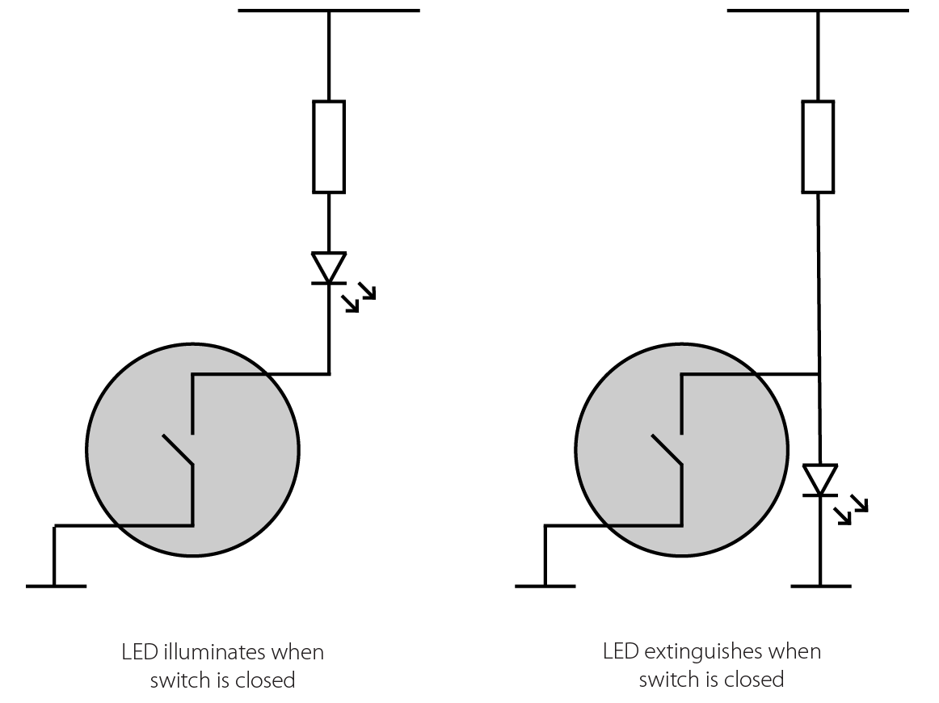
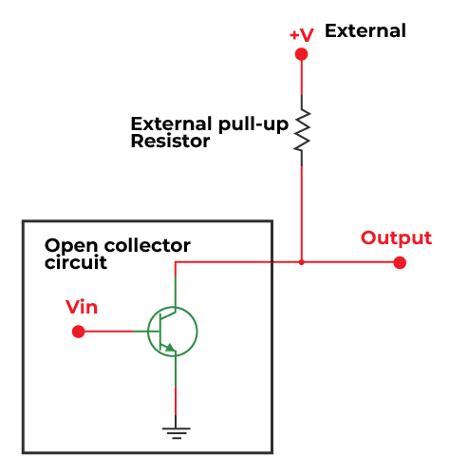
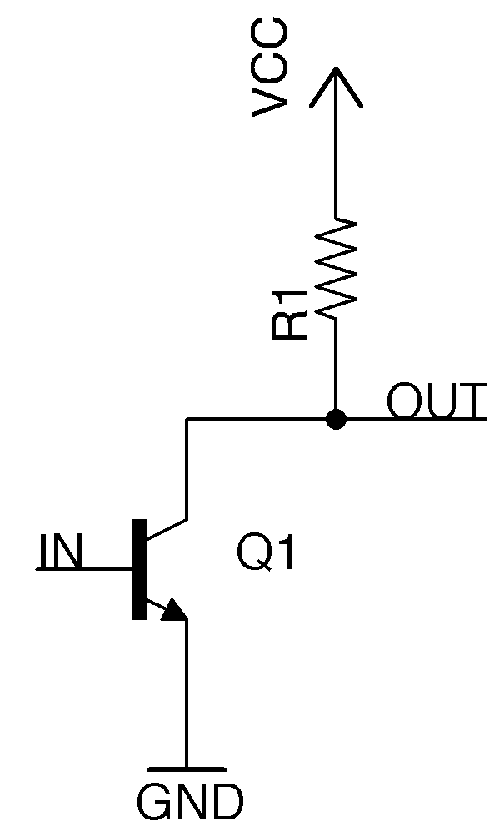
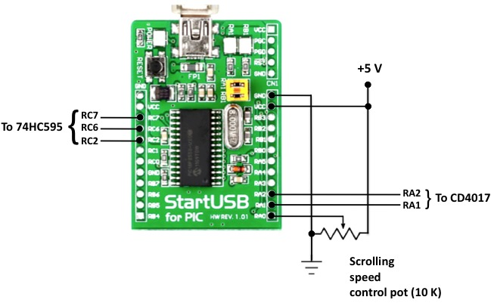
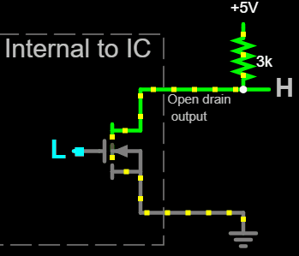
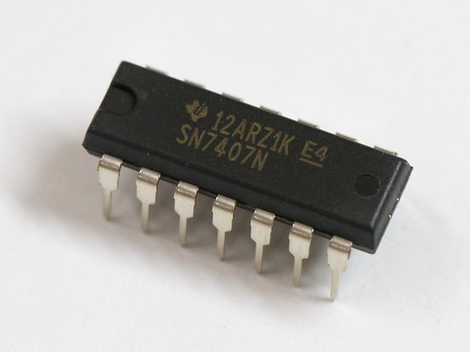
1
Function Of The Circuit
Open-collector or open-drain
Notes:
So, open-collector logic is like a special way to control signals in electronics, allowing multiple devices to work together to make a signal either on or off. I understood that the primary function of the open collector is to turn the output ON / OFF. The output that is connected to these terminals will act like a switch depending on the output. “The open collector works with DC power and basically toggles the current flow from the output signal wire to the ground” (Gems May 6, 2021). These available output configurations are often used for digital applications when the transistor acts as a switch, to allow for logic-level conversion, wired-logic connections, and line sharing.

Slide 4
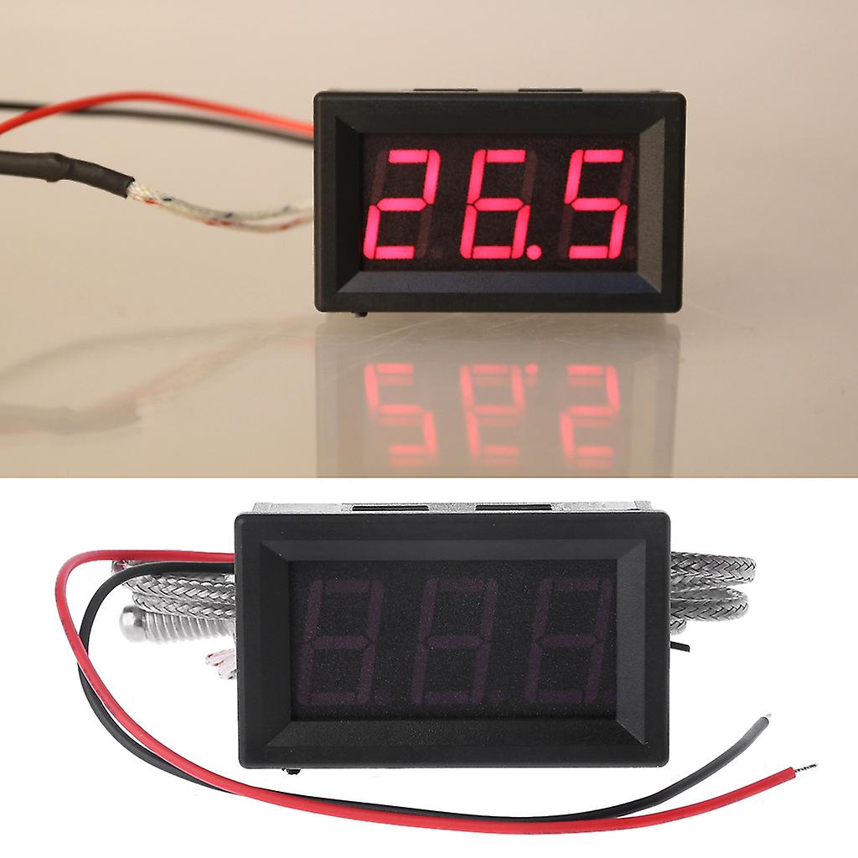
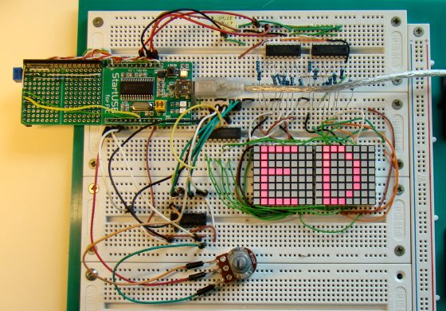


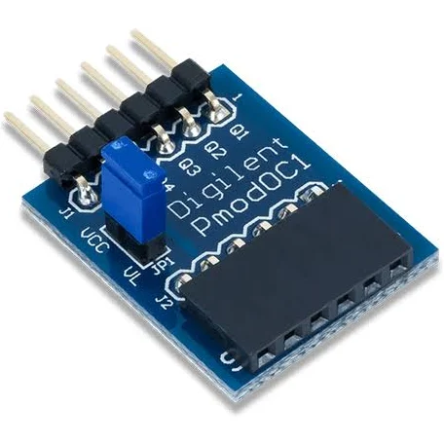
Where Is The Circuit Used?
Temperature sensor
It can be used in LED lighting, like the LED matrix displays.
Notes:
Open-collector logic finds versatile applications in scenarios demanding signal control and sharing. In LED matrix displays, it allow independent control of rows or columns, enabling dynamic visual outputs by selectively grounding rows or columns. Temperature sensors often employ open-collector outputs to indicate alarm states when specific temperature thresholds are surpassed, offering critical monitoring and alerting functionality. This configuration is prevalent in various industries, including automotive and industrial control, ensuring effective and reliable communication between components. By offering flexible signal coordination and level-shifting capabilities, open-collector logic significantly contributes to the efficiency and safety of LED displays and temperature monitoring systems in these diverse and critical domains.

Slide 5
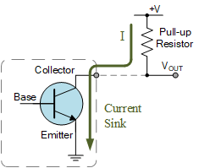

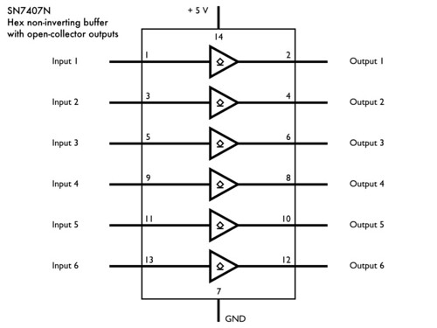


Advantages Of The Circuit
Notes:
Some advantages of Open-collector are astoundingly versatile in the realm of digital electronics, as they boast the remarkable capability to establish a wire OR connection between multiple outputs, thereby serving as a fundamental building block for intricate circuit configurations. One of their distinguishing features is their superior current-sinking capacity compared to standard outputs, which renders them exceptionally well-suited for driving an array of components, including but not limited to LEDs and various low-current devices, with remarkable precision and reliability. Furthermore, the materials used in the manufacturing of electronic components, including open-collector outputs, can impact their environmental footprint. Environmentally conscious practices, such as using sustainable materials and minimizing waste, can contribute to eco-friendliness.

Slide 6
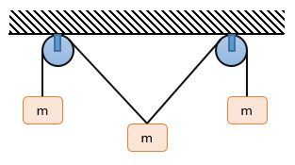





Disadvantages Of The Circuit
Tension
Additional Power
Saturn is the ringed and a gas giant
Increases component counter
Notes:
The cons of open-collector logic circuits primarily revolve around their limitations in certain applications. One is that it can potentially cause too much tension, where both sides are trying to pull at the output at the same time.“This happens when two or more devices are trying to pull the output low at the same time. In order to avoid this, proper design and layout techniques must be used” (manikanta2017, 09 Nov 2022). Second, these configurations require an external pull-up resistor, which increases component count and complexity. The need for this resistor also consumes additional power, impacting energy efficiency. Lastly, bidirectional communication using open-collector outputs can lead to bus contention problems, necessitating additional circuitry for collision detection and resolution.

Slide 7
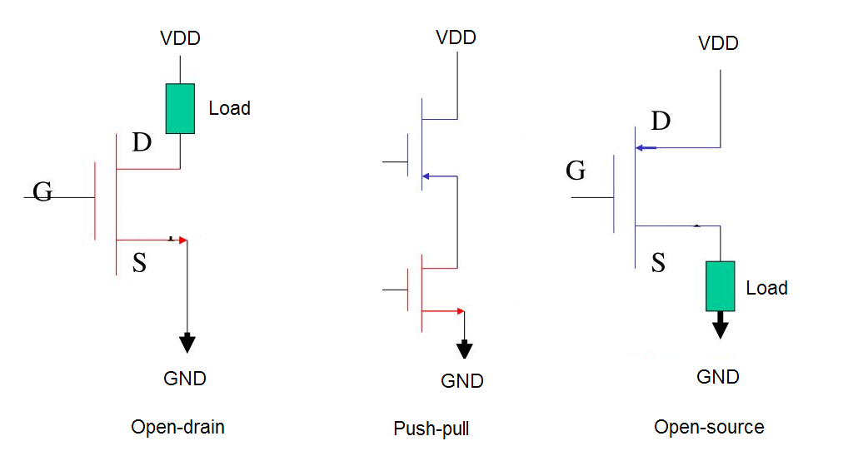
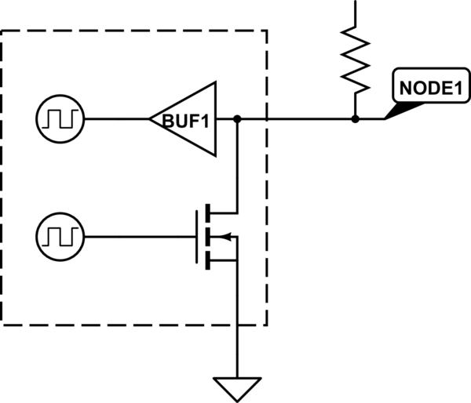
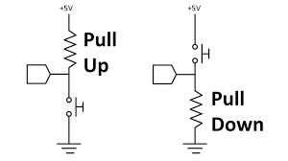
Variations Of The Circuit
Open-Collector with Pull-Up Resistor
Bidirectional Open-Collector
Notes:
Two notable variations of open-collector logic circuits include the Open-Collector with Pull-Up Resistor and the Bidirectional Open-Collector Configurations. In the Open-Collector with Pull-Up Resistor configuration, a single open-collector output shares a pull-up resistor, enabling efficient signal coordination and logic-level conversion. By adjusting the resistor value, the speed of signal transitions can be tailored to meet specific requirements. On the other hand, the Bidirectional Open-Collector Configuration facilitates bidirectional communication on a shared bus, where both input and output devices can use open-collector outputs. This approach is essential for systems requiring multiple devices to transmit and receive data over a common communication medium, ensuring efficient and reliable data exchange.

Slide 8
Resources 1
A, admin. (2022, June 1). Benefits between open circuit and closed circuit. Tech Talk. https://www.techatalk.com/benefits-between-open-circuit-closed-circuit/
A, N. (2022, September 29). Premium vector: Power consumption reducing icon vector. Freepik. https://www.freepik.com/premium-vector/power-consumption-reducing-icon-vector_32461830.htm
Ambitiously, E. (2023, February 21). Product documentationEngineer Ambitiously. NI. https://www.ni.com/docs/en-US/bundle/ni-hsdio/page/hsdio/fopen_collector.html#:~:text=The%20main%20applications%20for%20open,any%20device%20drives%20a%20zero.
Bykhalets, R. (2000). Istock. iStock. https://www.istockphoto.com/illustrations/power
Controls, G. S. (2021, May 6). How does an open collector output work?. Gems Sensors & Controls. https://www.gemssensors.com/blog/blog-details/how-does-an-open-collector-output-work
Errington, M. (2023, February 23). How -to guide: Use an open collector output. Gill Sensors & Controls. https://gillsc.com/how-to-guide-use-an-open-collector-output/
GoldenRetriever, T. (1966, April 1). What is an open collector?. Electrical Engineering Stack Exchange. https://electronics.stackexchange.com/questions/473366/what-is-an-open-collector

Slide 9
Resources 2
Main, J. (2005). How to easily drive a an LED dot matrix display: 8x8 or 5x7 leds. Best Microcontroller Projects. https://www.best-microcontroller-projects.com/led-dot-matrix-display.html
manikanta2017, manikanta2017. (2022, November 9). Open-collector logic. GeeksforGeeks. https://www.geeksforgeeks.org/open-collector-logic/#
Oskay, W. (2012, February 29). Evil mad scientist laboratories. https://www.evilmadscientist.com/2012/basics-open-collector-outputs/
R-B, R. B. (2011, May 21). LAB 15: SCROLLING TEXT MESSAGE ON AN LED DOT-MATRIX DISPLAY. Embedded lab. https://embedded-lab.com/blog/lab-15-scrolling-text-message-on-an-led-dot-matrix-display/
Schmidt, A. (2017, November 9). What does “Open collector” mean? Key. https://forum.digikey.com/t/what-does-open-collector-mean/715
user22348user22348. (1961, May 1). How does open drain IO act as bidirectional. Electrical Engineering Stack Exchange. https://electronics.stackexchange.com/questions/152993/how-does-open-drain-io-act-as-bidirectional
Wahyuni, M. S. (2022, July 11). Continuous one line drawing business man and woman communicate with Old Technologies. communication and project management concept. Single Line Draw Design Vector Graphic Illustration. Vecteezy. https://www.vecteezy.com/vector-art/8962965-continuous-one-line-drawing-business-man-and-woman-communicate-with-old-technologies-communication-and-project-management-concept-single-line-draw-design-vector-graphic-illustration

